Slide 1
Platinum Data Project Wang Biyuan
2016.07.26 Presentation

Slide 2
Project Progress
Step I: Import data into MATLAB 【Done】
Step II: Data interpolation 【Processing】
Step III: Data average 【To be done】

Slide 3

Project Progress
Step II: Data Interpolation
Aim: ensure the consistency of data length
400
400
400
Notes:
By either truncation or interpolation

Slide 4
Project Progress
Step II: Data Interpolation
Preparation :
Extracted raw data
All field sizes, scan depths and curve types in one file
Classified raw data
Data of the same field size, scan depth and curve type in separated files
Classification according to data requirements

Slide 5
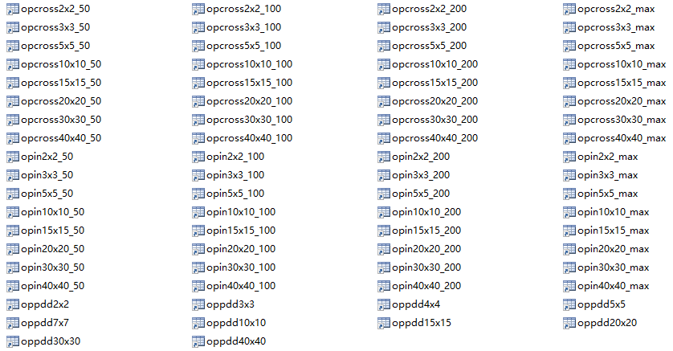

Project Progress
Step II: Data Interpolation preparation
or

Slide 6
Project Progress
Step II: Data Interpolation preparation
Data classification
Self-written function: onepunch(fpath)
Description:
-Input- file path
-Output- .mat Nx6 matrices classified by required parameters
Pros:
-Data can be mixed together
-All the classifications can be done in one take
Cons:
-Low calculation speed due to lots of implemented loops

Slide 7
Future Work Plan
The standard data length (according to the type of measurement)
Tweak the interpolation method
Check the reliability of averaged data by comparing with raw data plot

Slide 8
THE END Thank you for your patience!

